Slide 1
Synapse Administration

Slide 2
Security

Slide 3
Shared Responsibility
Microsoft Controls
You Control
Specific hardware
Available encryption options
Network access and routing
Access to systems
Choice of encryption: Microsoft’s or yours
Data fidelity and access rights

Slide 4
Key Principles – Mostly Microsoft
Encrypt data at rest
Dedicated SQL pool data encrypted on disk and can use TDE
Data lake data encrypted on disk
Backups encrypted automatically
Encrypt data in transit
TLS required for all communications
Options available to prevent routing over the public internet

Slide 5
Key Principles – Mostly You
Ensure sensitive data is necessary to store
Follow regulatory compliance requirements and guidelines
Consider whether you need the data
Don’t have it, can’t lose it
Remove obsolete data
Create lifecycle management policies on Azure storage
Partition data in dedicated SQL pool and roll off old partitions
Data Explorer pool has built-in lifecycle management
Reduces consequences of data breach and can save money
Grant access as needed

Slide 6
Business Continuity – High Availability
Dedicated SQL pools highly available by default—no need (or ability) to set up, e.g., Availability Groups
Serverless SQL pool high available, though can be flaky
Spark pool availability: burn it down and start over!
Data Explorer pool highly available within a region
Uses Azure Storage under the covers
Compute nodes available in multiple zones within a region but no built-in cross-region high availability

Slide 7
Business Continuity – Disaster Recovery
Dedicated SQL pool offers automated snapshot with RPO of 8 hours and retention of 7 days
Can take manual snapshots of dedicated SQL pools
Recommended to use Geo-Redundant Storage (GRS) for data lake storage; Read-Access (RA-GRS) okay but not required
Data Explorer pools may be clustered in paired regions
Ex: East US – West US, East US 2 – Central US, North Europe – West Europe

Slide 8
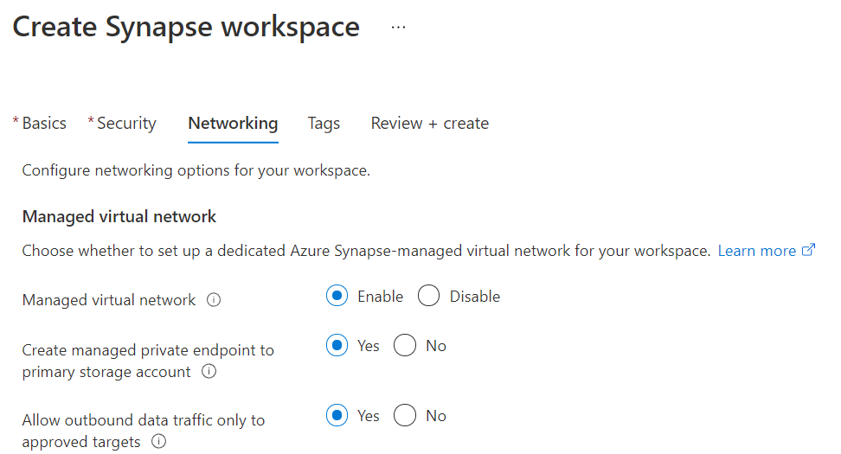
Two Critical Setup Options

Slide 9
Managed Virtual Networks
MUST be enabled at workspace creation time
Cannot enable or disable later
Creates a Synapse workspace in a VNet Microsoft owns
Cannot build Synapse resources in a customer-owned VNet
Segregates Spark pools into individual subnets
Puts Synapse workspace on its own VNet
Opens up only ports necessary for communication
Necessary to prevent public network access
Enables managed private endpoints for Azure services

Slide 10
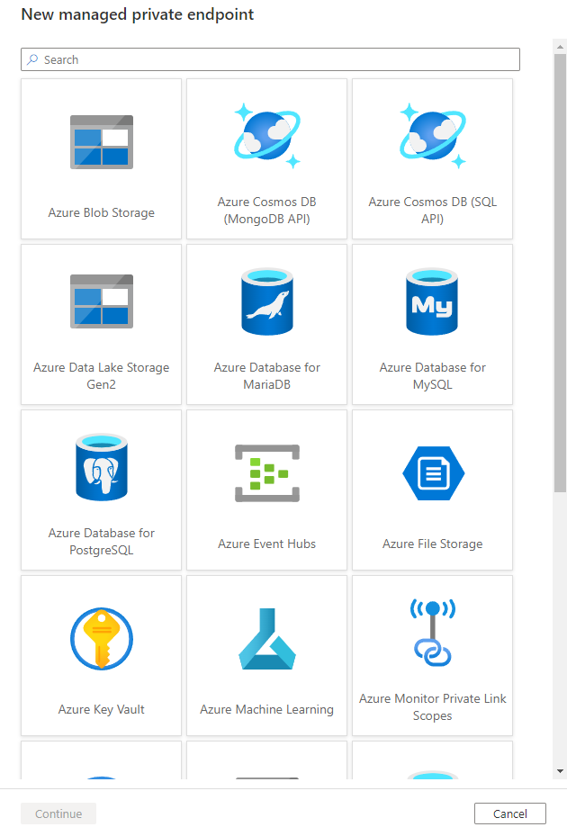
Managed Private Endpoint
Most secure way of connecting with an Azure resource
Packets transit only on Azure backbone—never enter the public internet
Only available for a limited number of Azure resources
Whenever possible, use these!

Slide 11
Data Exfiltration Protection
“Allow outbound data traffic only to approved targets”
MUST be enabled at workspace creation time
Cannot enable or disable later
Limits workspace communication: may only connect to managed private endpoints or Integration Runtimes
Limits Azure AD tenants to which you may write data
Prevents pools from hitting the public internet
Can’t call pip or conda to install packages!
Use this if necessary but understand the (annoying) consequences

Slide 12
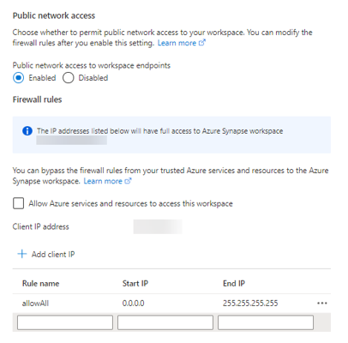
Other Security Options
IP address whitelisting
Similar to IP firewall for Azure SQL DB
No ability for CIDR notation and limited number of rules
“Allow Azure services and resources to access this workspace”
“Easy button” for allowing Azure services to communicate with the workspace
Allows all Azure services—not just your own!—to access if authorized
Unnecessary to select—all relevant tasks can be done without this checked

Slide 13
Roles and Rights

Slide 14
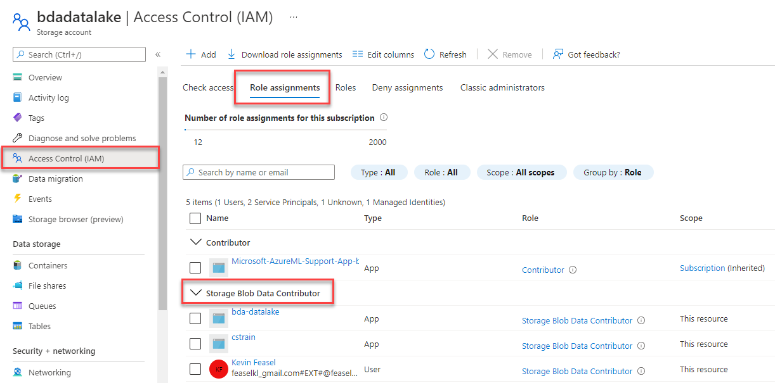
Storage Blob Data Contributor

Slide 15
Synapse RBAC Roles
Synapse Administrator
Spark Administrator
Full access to everything inside Synapse
Along with Azure Owners, assign RBAC roles to others
Still need Azure permissions (workspace Owner / Contributor) for compute resource management
Create and manage Spark pools
Can work with Spark notebooks and job definitions
Can NOT run Synapse Pipelines or grant access to others

Slide 16
Synapse RBAC Roles
SQL Administrator
Artifact Publisher
Full access to the serverless SQL pool
Manage dedicated SQL pools—creating logins, granting access
Manage scripts, credentials, linked services
Can NOT run Synapse Pipelines or grant access to others
Read and manage published code artifacts & outputs
Does NOT include permissions to run code/pipelines or grant access to others
Artifact User provides read-only access but no management options

Slide 17
Synapse RBAC Roles
Credential User
Monitoring Operator
Use secrets within credentials and linked services
Required for activities like pipeline runs
Read published code artifacts & outputs for notebooks and pipeline runs
View serverless SQL pool, Spark pool, Data Explorer pool, and Integration Runtime details
May NOT run/cancel pipelines or Spark jobs

Slide 18
Synapse RBAC Roles
Compute Operator
Synapse Contributor
Submit Spark jobs/notebooks and view logs
May cancel Spark jobs from ANY user
May run pipelines and view pipeline runs/outputs if also given Credential User access
Includes ALL Compute Operator permissions
Full access to Spark pools and Integration runtimes
May work with published code artifacts
Requires Credential User to run pipelines

Slide 19
Synapse RBAC Roles
Synapse User
List and view details on pools, Integration Runtimes, and published linked services + credentials
May NOT review published code artifacts
May create new artifacts but require other permissions to run/publish

Slide 20
Logging and Alerting

Slide 21
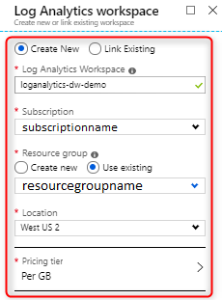
Log Analytics
Azure mechanism for storing log data
Query results using KQL
May NOT send results to a Data Explorer pool!

Slide 22
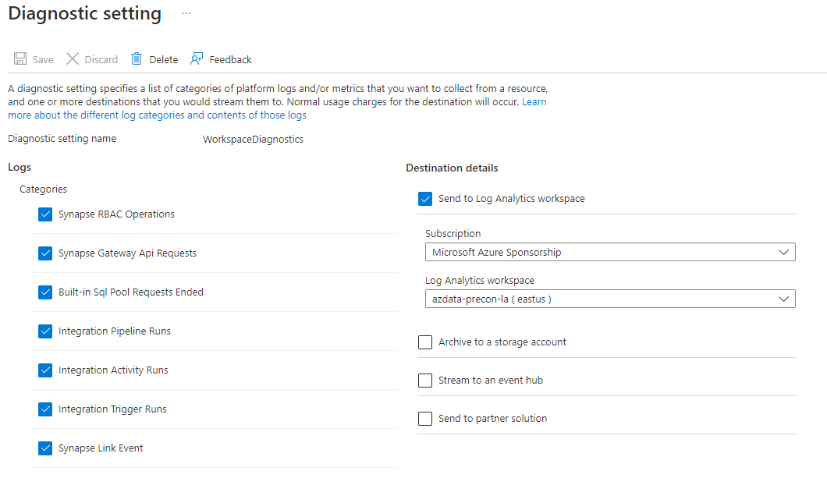
Workspace Logging

Slide 23
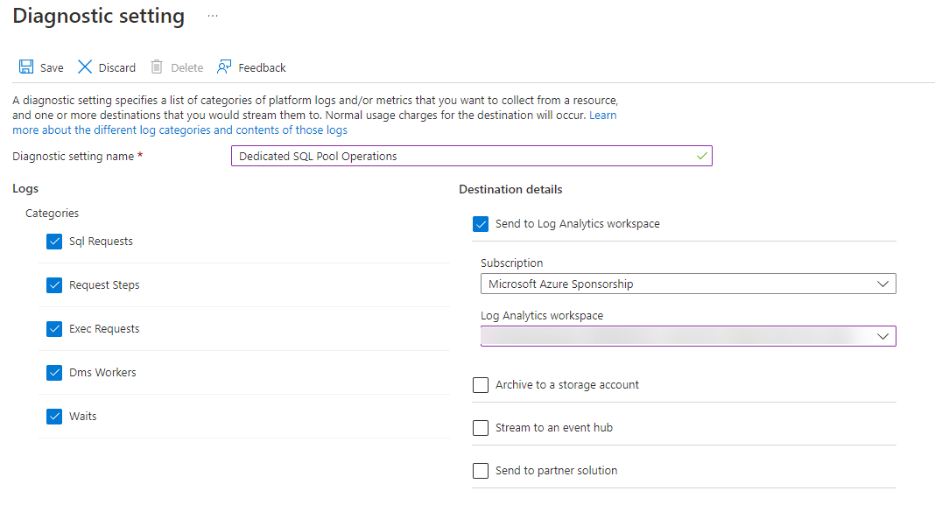
Dedicated SQL Pool Logging

Slide 24
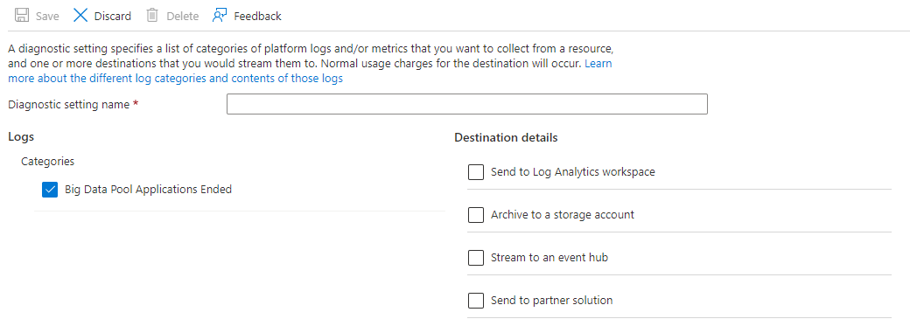
Spark Pool Logging

Slide 25
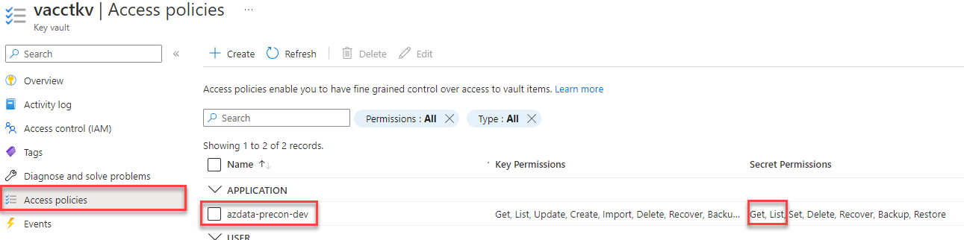
Spark App Logging
Step 0: ensure you have the following resources
Log Analytics
Key Vault
Add a linked service to Key Vault from Synapse
Ensure the managed identity has Secret permissions on KV

Slide 26
Spark App Logging
Step 1: create a text file with the following details
spark.synapse.logAnalytics.enabled true spark.synapse.logAnalytics.workspaceId <workspace-guid> spark.synapse.logAnalytics.keyVault.name <keyvault-name> spark.synapse.logAnalytics.keyVault.linkedServiceName <keyvault-linkedservice-name> spark.synapse.logAnalytics.keyVault.key.secret log-analytics-secret-key

Slide 27
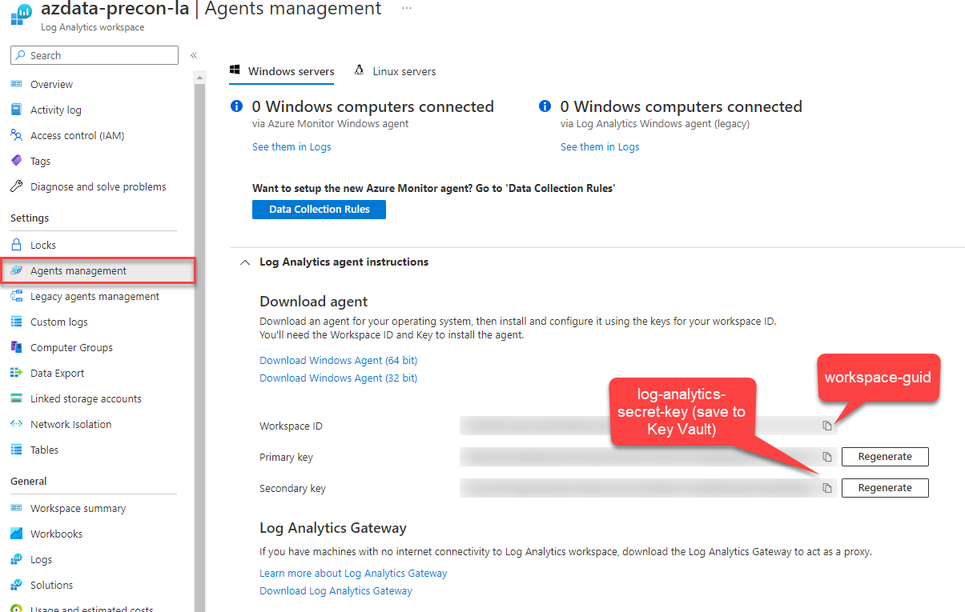
Spark App Logging

Slide 28
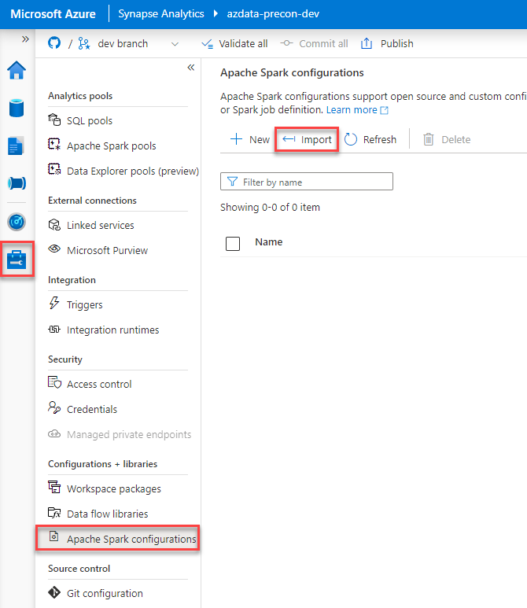
Spark App Logging
Step 2: Upload the file

Slide 29
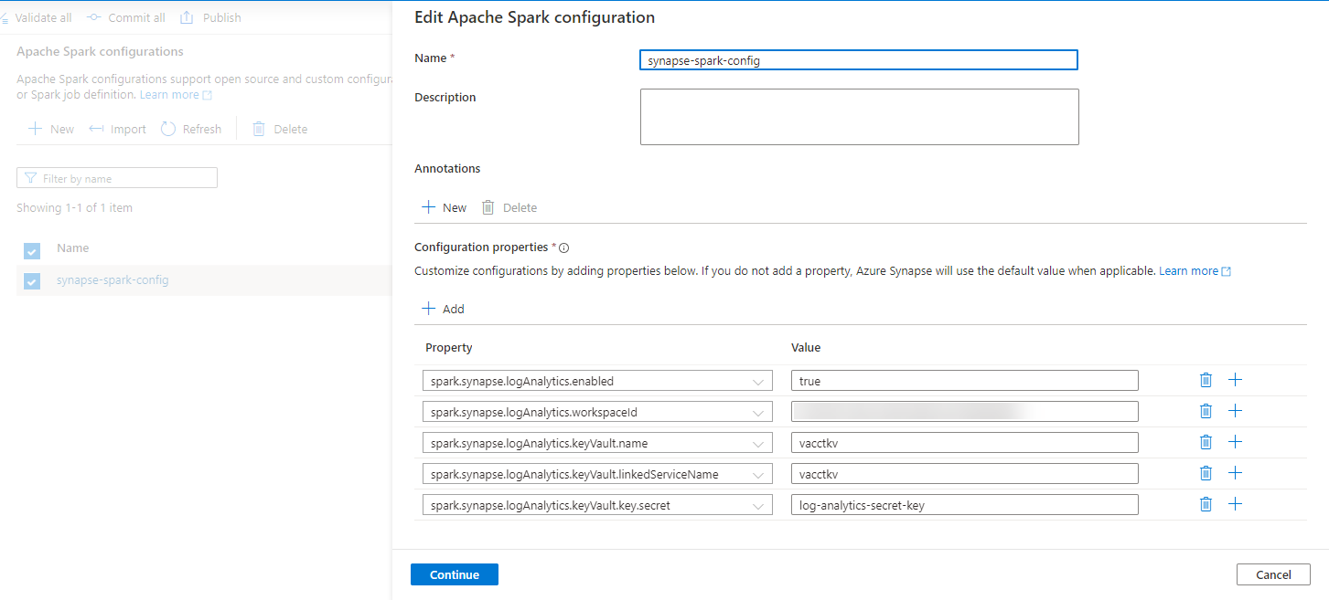
Spark App Logging
Step 2: Upload the file

Slide 30
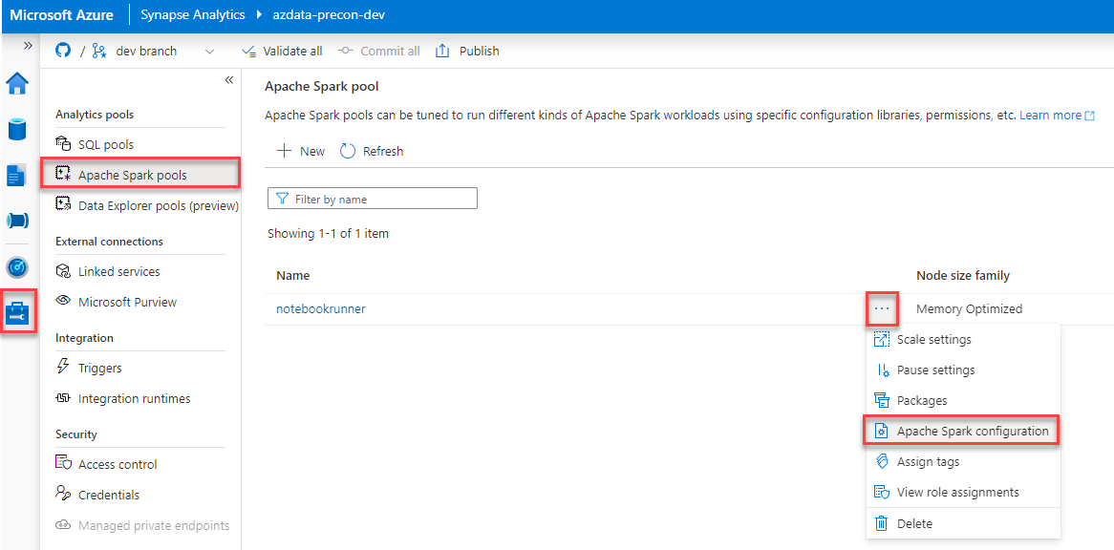
Spark App Logging
Step 3: Apply the configuration

Slide 31
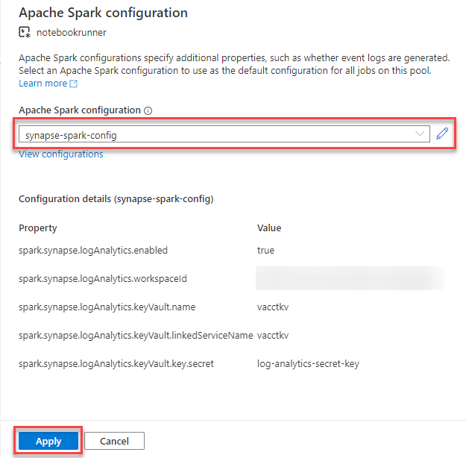
Spark App Logging
Step 3: Apply the configuration

Slide 32
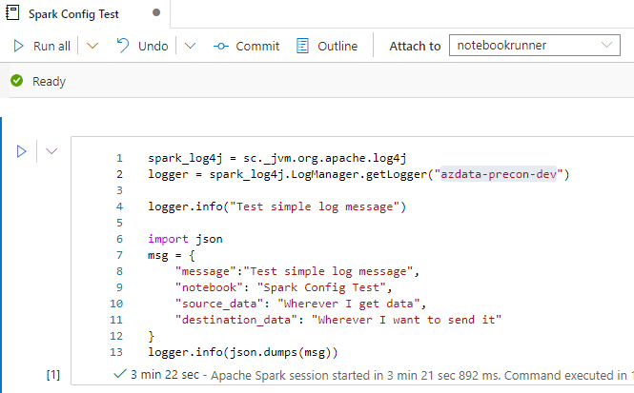
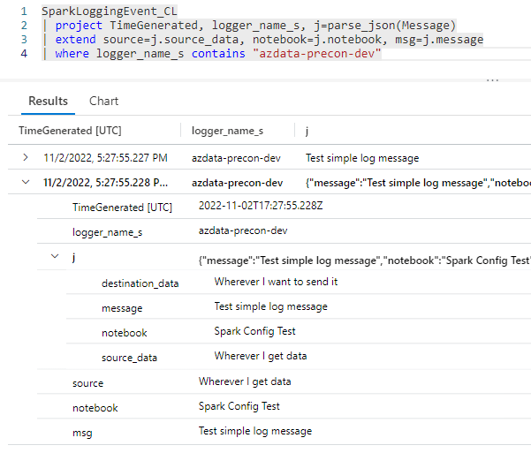
Spark App Logging
Step 4: Try it out
(May take a few minutes)

Slide 33
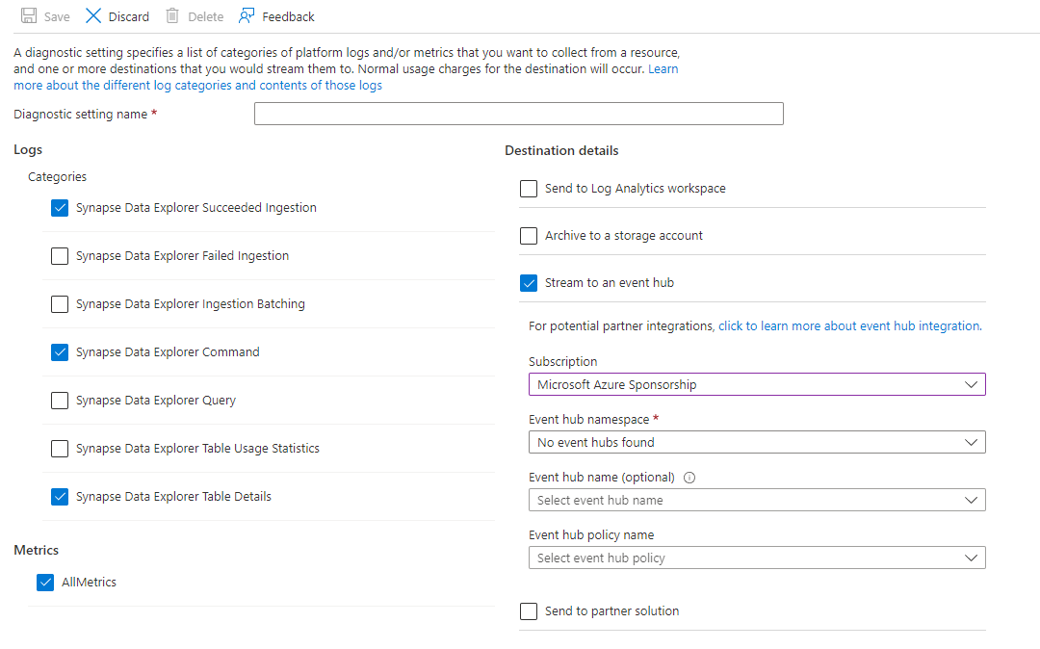
Data Explorer Pool Logging

Slide 34
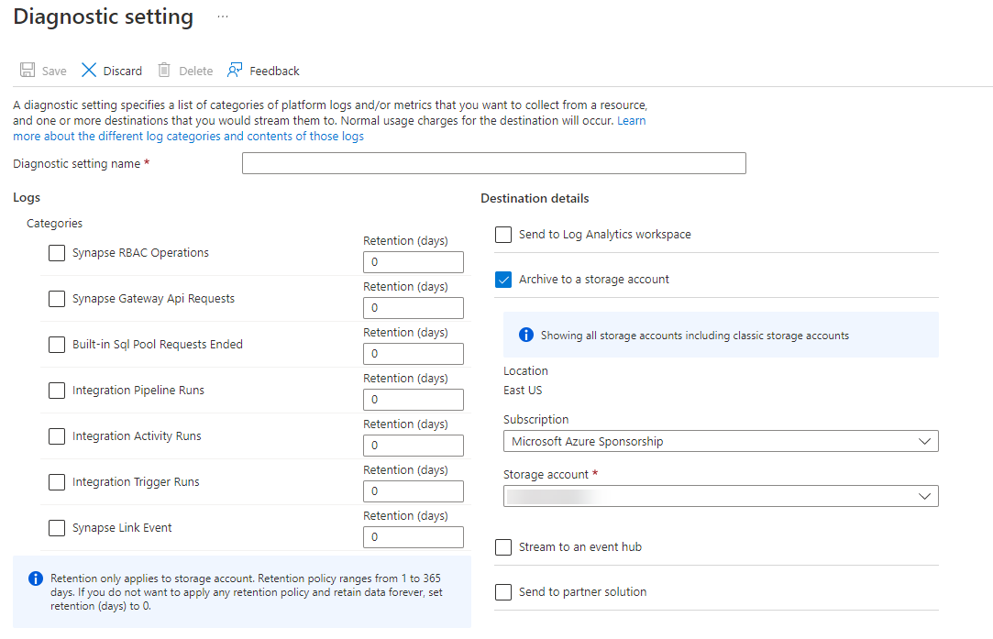
Synapse Pipeline Logging

Slide 35
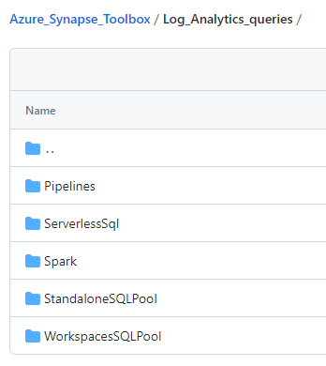
Querying Data in Log Analytics
Queries available in the Azure Synapse Toolbox
Requires data in Log Analytics
Pre-created KQL queries to analyze SQL pools, Spark pools, and Synapse Pipelines
Several places to submit queries: Log Analytics in portal, Logs in Synapse workspace, az CLI, etc.

Slide 36
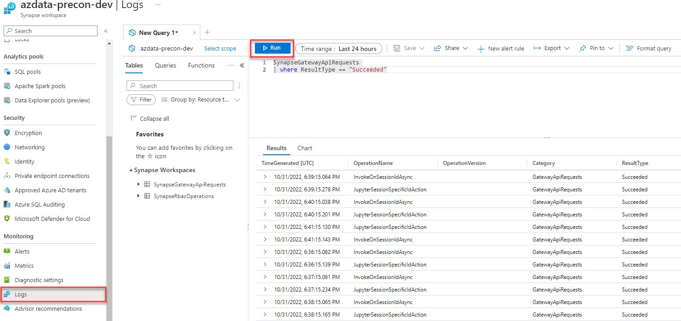
Running a Log Analytics Query

Slide 37
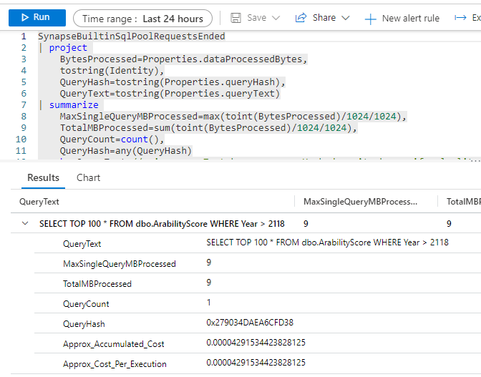
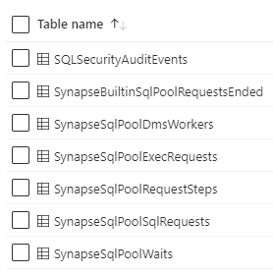
Running a Log Analytics Query
Diagnostics tables available in Log Analytics if you enabled them

Slide 38
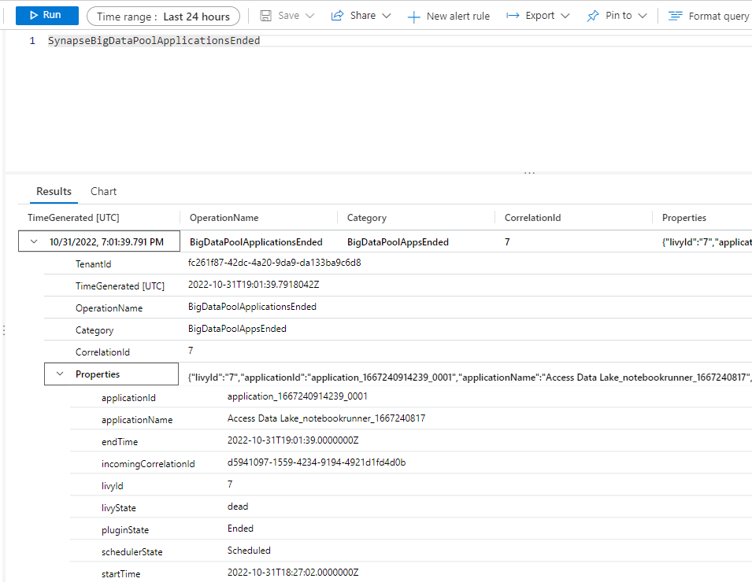
Running a Log Analytics Query
Spark pools contain limited information, primarily in the applications ended table

Slide 39
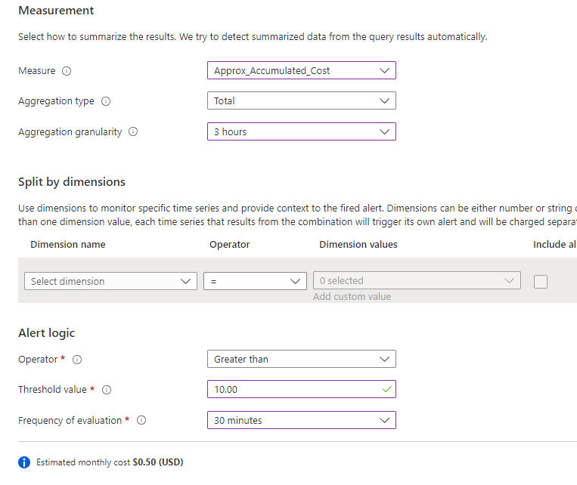

Log Analytics Alerting

Slide 40
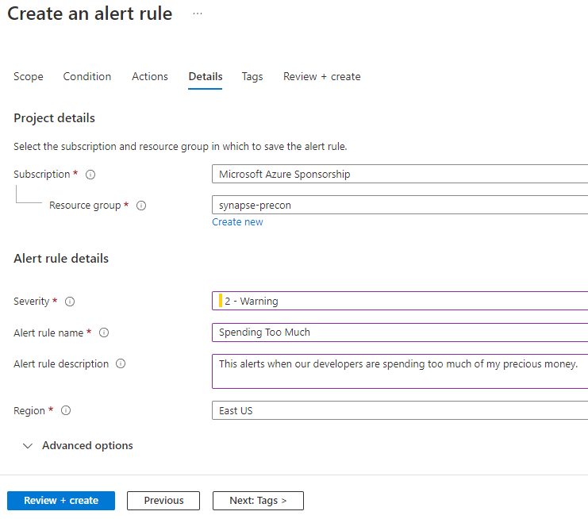
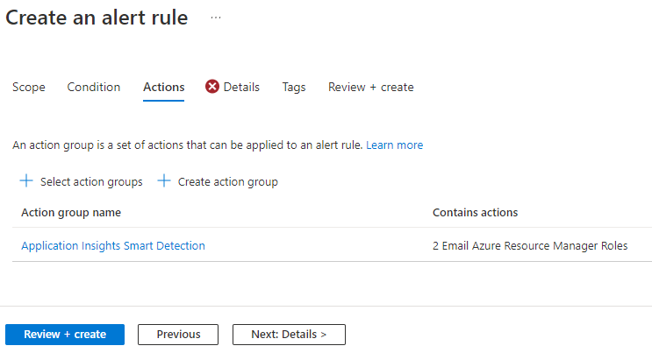
Log Analytics Alerting

Slide 41
Monitoring

Slide 42
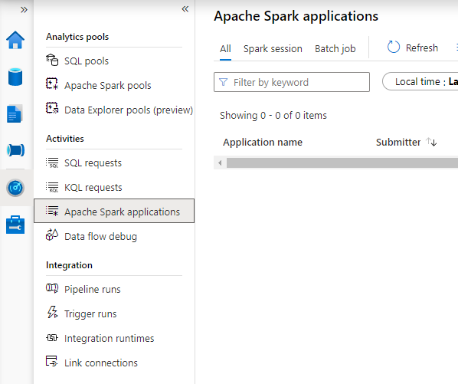
Reviewing the Monitor Hub
“Single pane of glass” view of pools and tooling (Pipelines and Link)
Filter specific SQL, KQL, or Spark activities

Slide 43
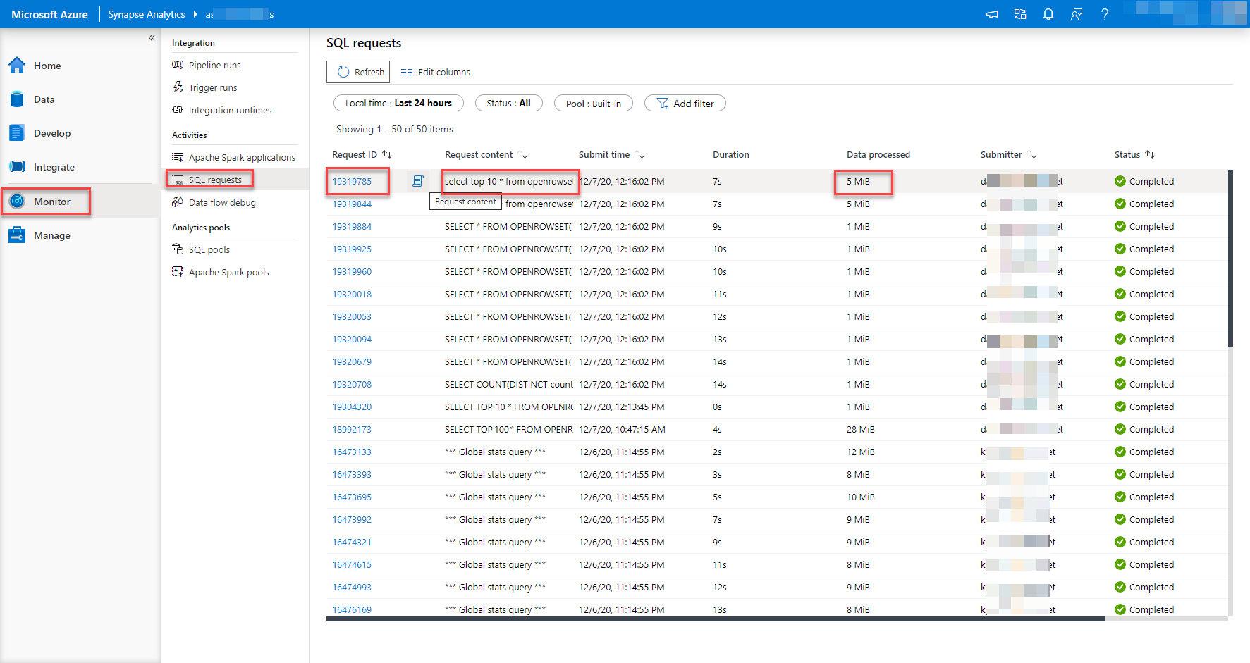
SQL Pool Monitoring

Slide 44
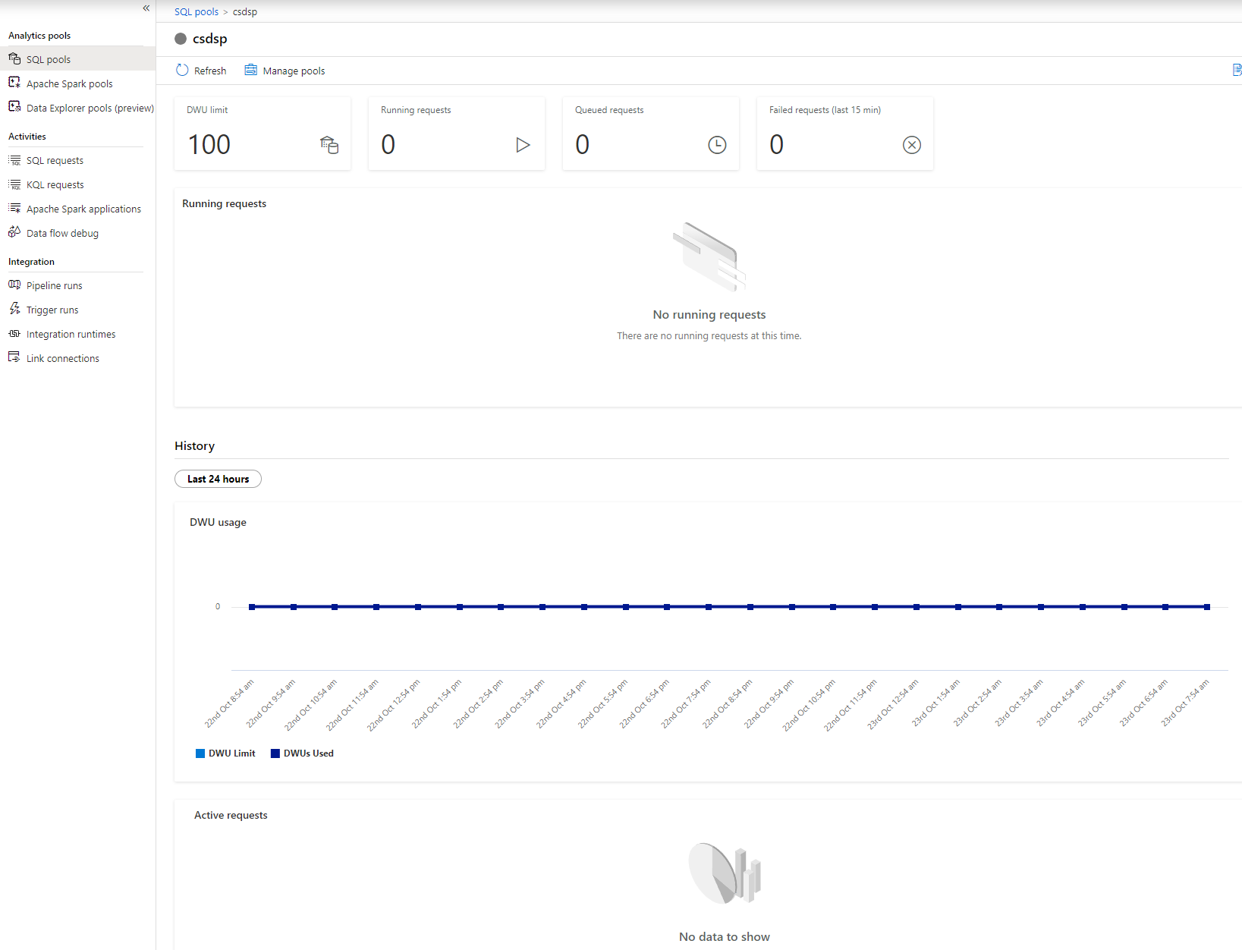
SQL Pool Monitoring

Slide 45
Monitoring SQL Pools via DMV
Require VIEW DATABASE STATE or CONTROL permission
sys.dm_pdw_exec_sessions
sys.dm_pdw_exec_requests
sys.dm_pdw_sql_requests
sys.dm_pdw_request_steps
sys.dm_pdw_waits
Microsoft Learn has more details

Slide 46
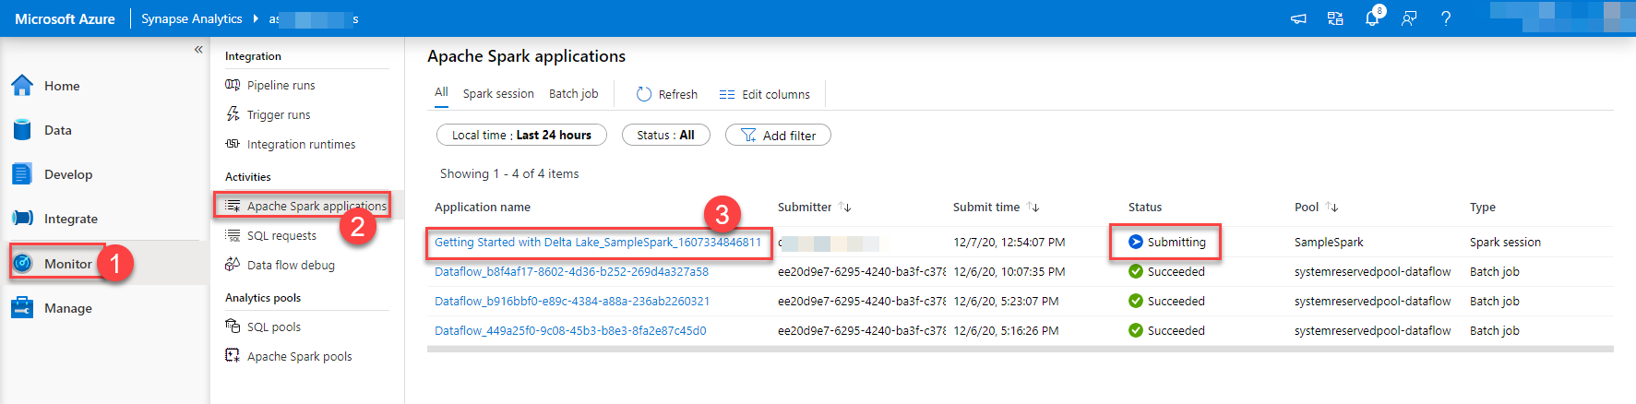
Spark Pool Monitoring

Slide 47
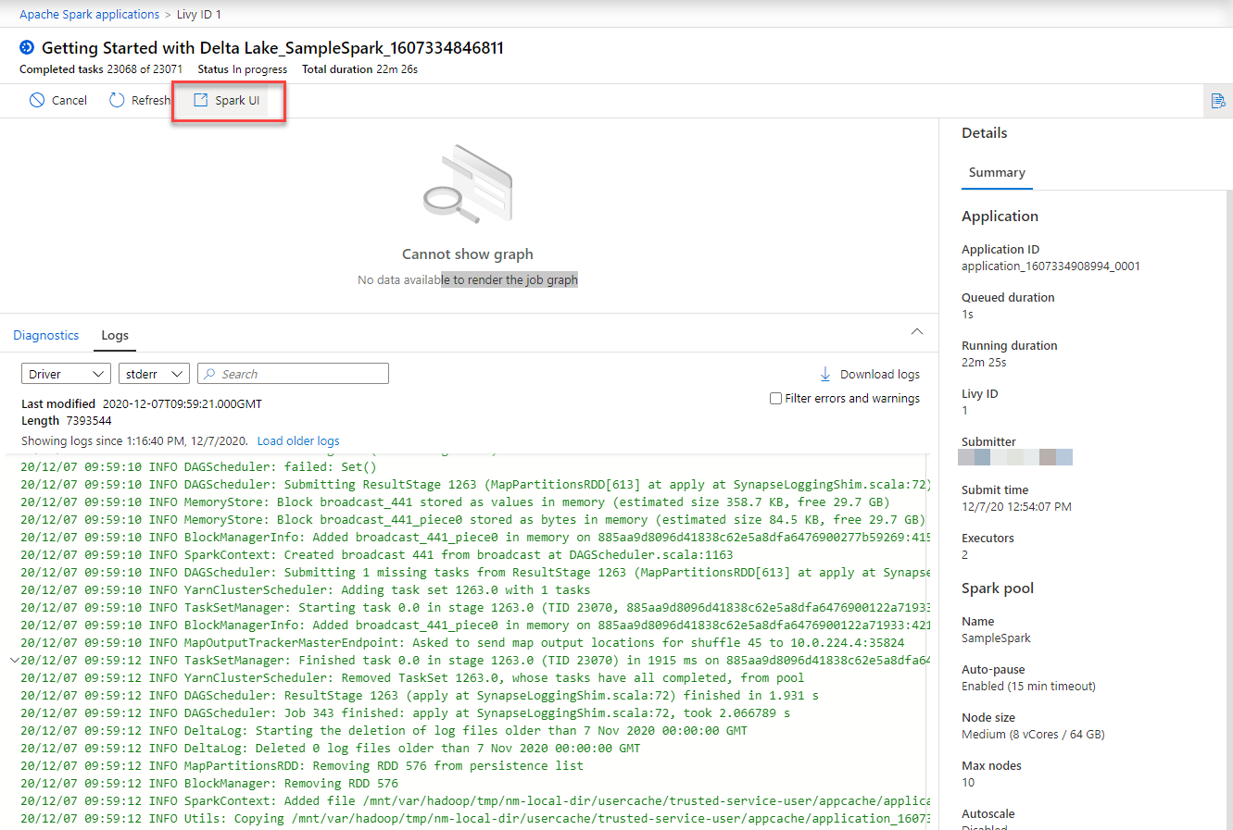
Spark Pool Monitoring

Slide 48
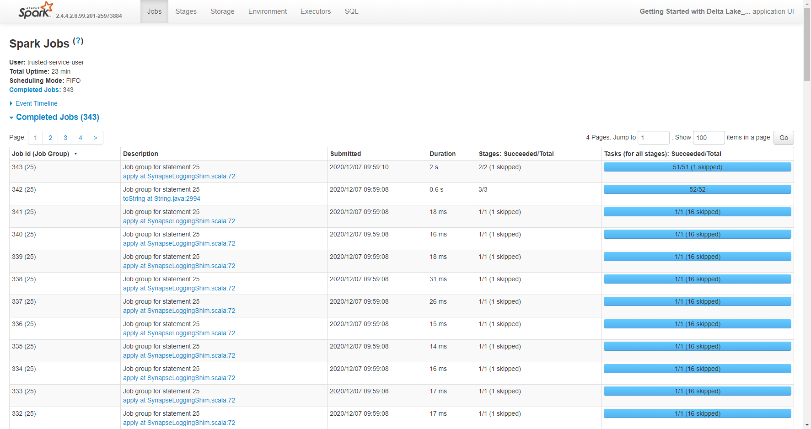
Spark Pool Monitoring

Slide 49
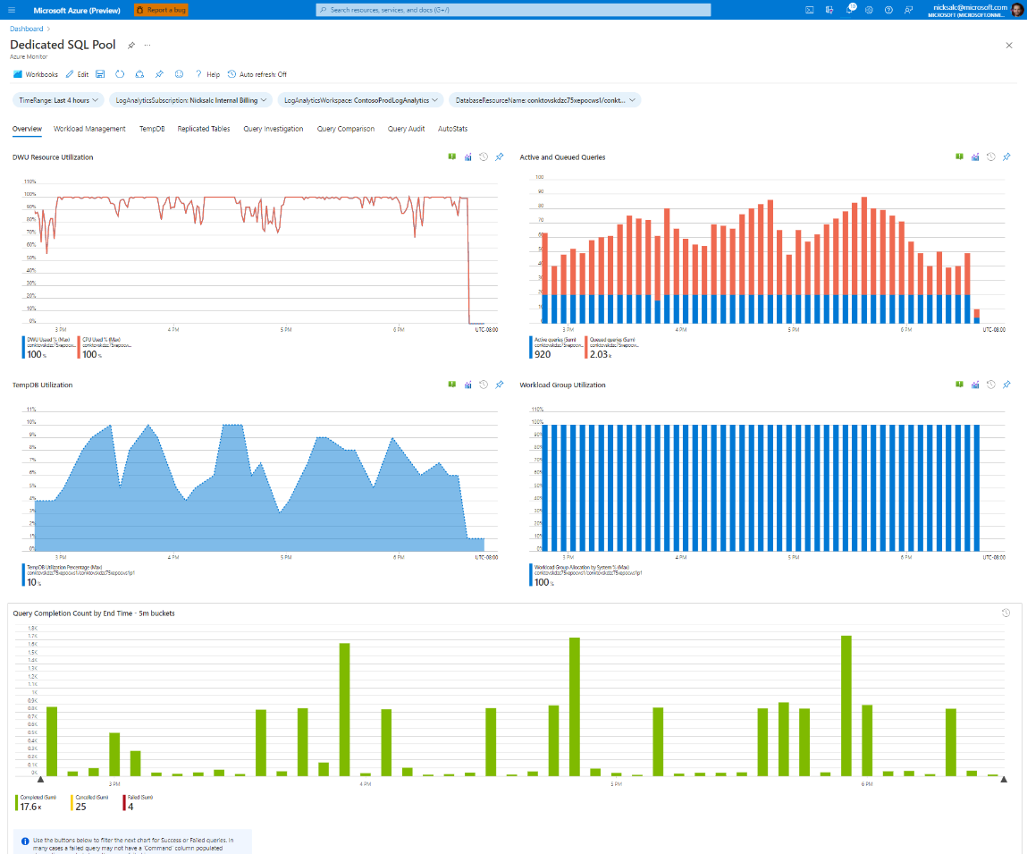
Monitor Workbooks
Part of the Azure Synapse Toolbox
Requires data in Log Analytics
Includes components for dedicated & serverless SQL pools and Synapse Pipelines

